Slide 1
Rotational Dynamics
Look the theme has circles which can rotate now you are contractually bound to laugh

Slide 2
Questions?
If you have any, ask in the discord or google classroom
Link to classroom: Electricity and Magnetism (google.com)

Slide 3
Force

Slide 4
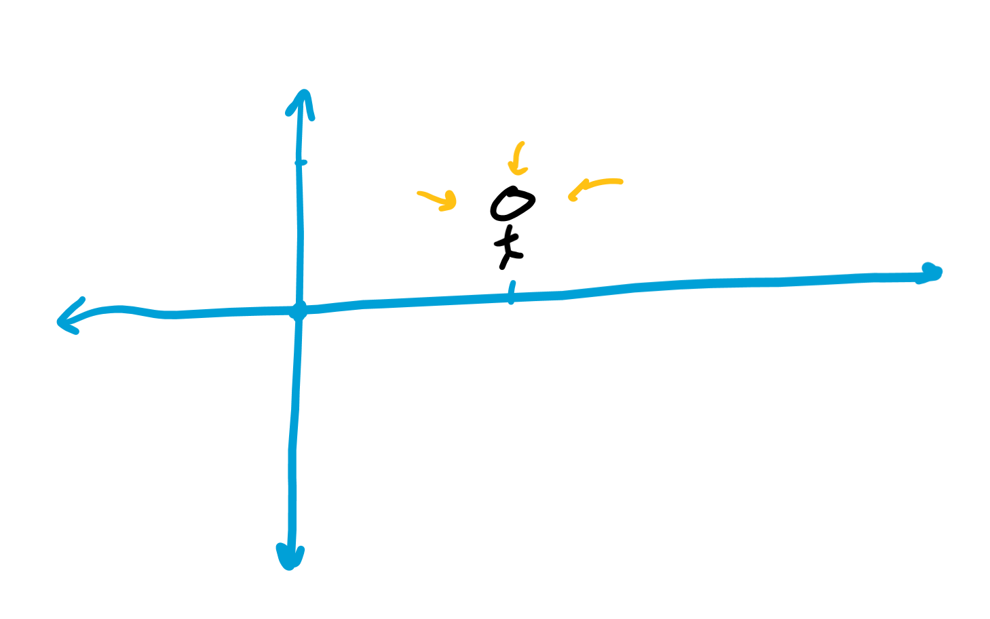
Position
Where you are
Measured in meters (m)

Slide 5
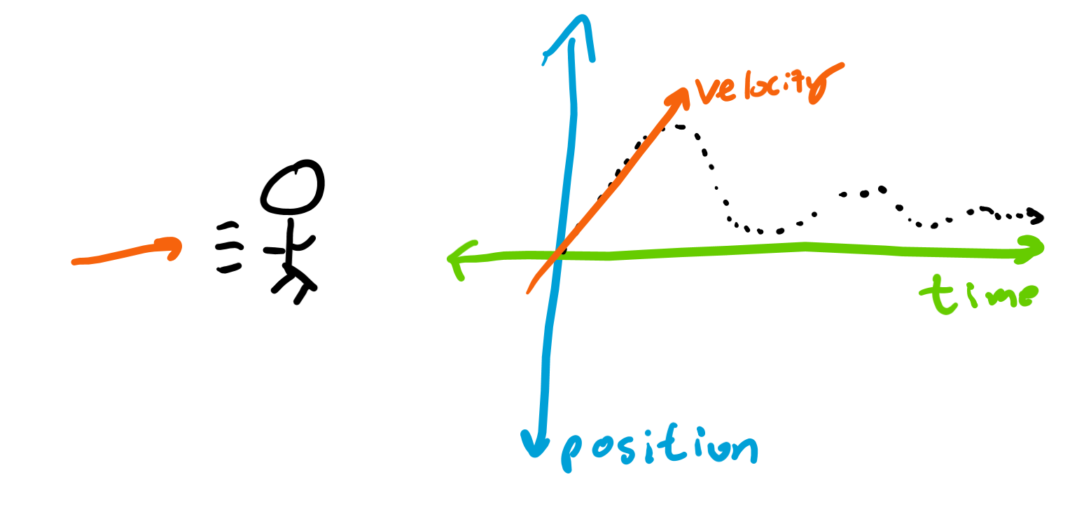
Velocity
How fast you’re moving
Change in position over time
Measured in meters divided by seconds (m/s)

Slide 6
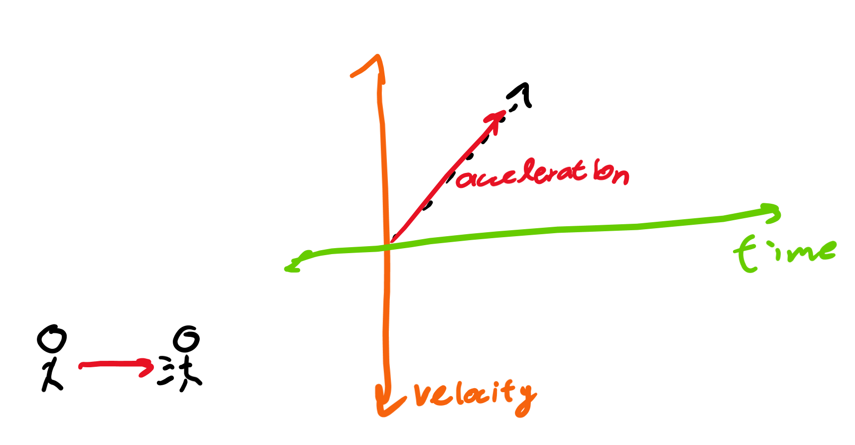
Acceleration
How fast your speed is changing
Change in velocity over time
Measured in meters per second per second (m/s/s = m/s^2)

Slide 7
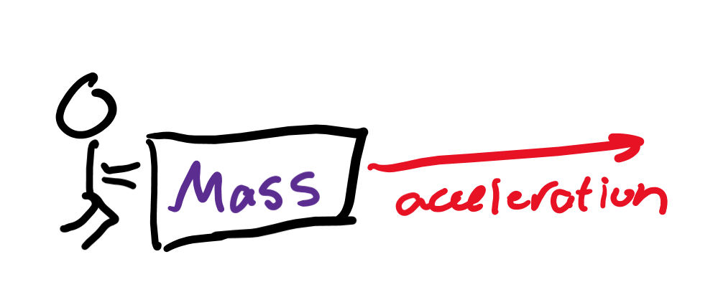
Force
How much something “pushes” something else
Depends on how heavy something is
Depends on how much you accelerate it

Slide 8
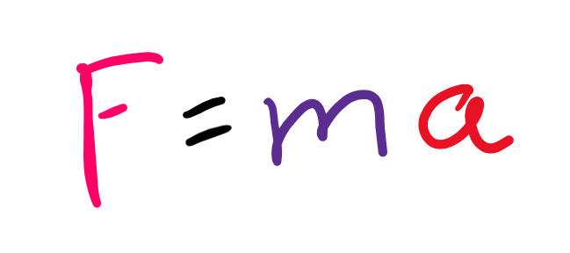
Equation
If you accelerate something more (like punting vs tapping a ball) you exert more force
If you accelerate a heavier mass (bowling instead of ping pong ball) you exert more force
If mass or acceleration increase, force does too

Slide 9
Gravity

Slide 10
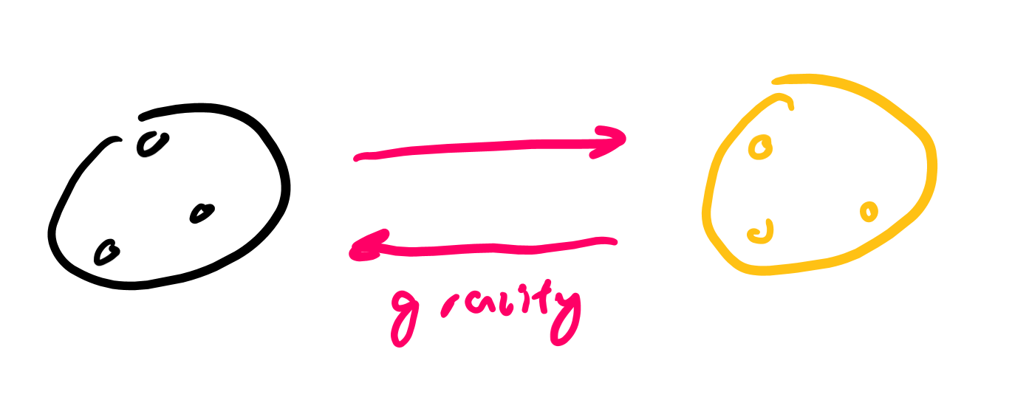
What is gravity?
A force things with mass exert
All things with mass exert an “attractive” force on other objects
More massive things exert more force
The closer objects are, the more they can attract each other

Slide 11
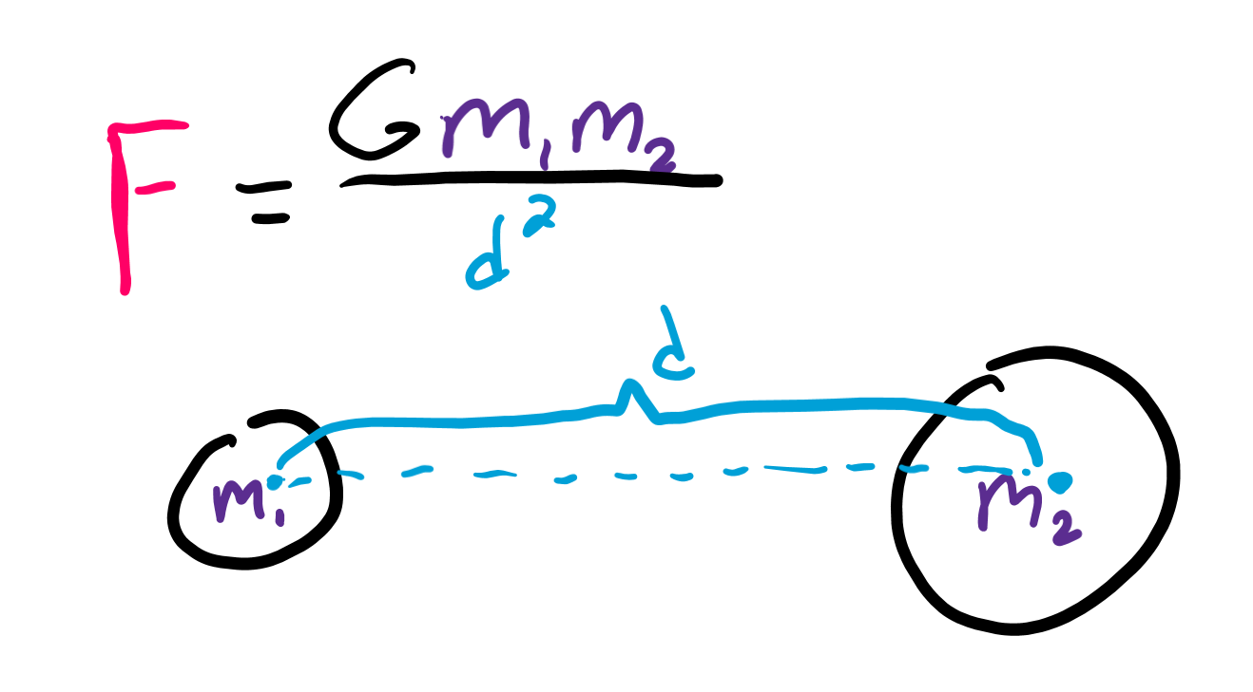
Newton’s Law of Universal Gravitation
Let’s say we have two objects
The more mass both objects have, the more “force” they exert on each other (mass in numerator)
The further they are away from each other, the less “force” they exert (distance in denominator)
G (big G) is a constant used to make units work out

Slide 12
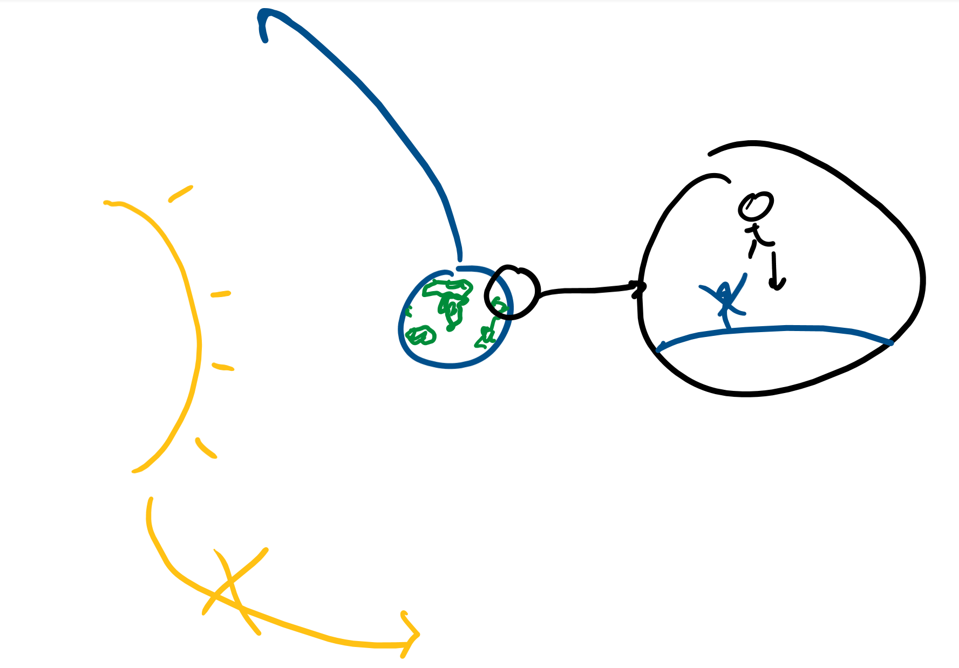
Weirdness
The gravitational force objects apply on each other are the same (I apply the same force on the earth as the earth does on me)
Why does the earth not move super quickly because of my gravity?

Slide 13
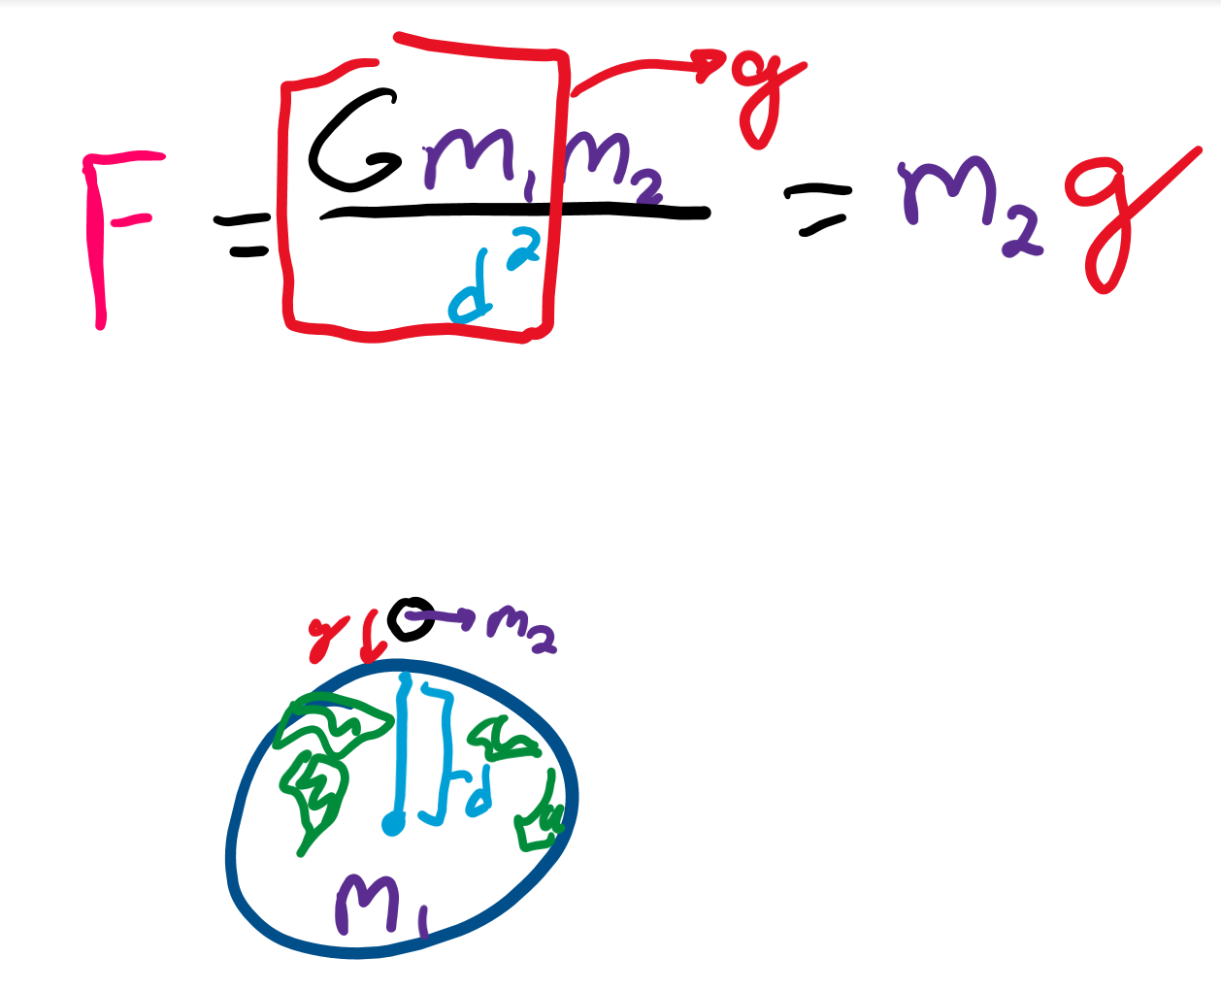
Small g
On earth, the distance between me and the center of the earth, the mass of the earth, and big G won’t change
Only thing that can change is my mass
Combine the “constants” to be a new constant, small g
That’s the acceleration due to gravity!
Small g stands for gravitational acceleration

Slide 14
Torque

Slide 15
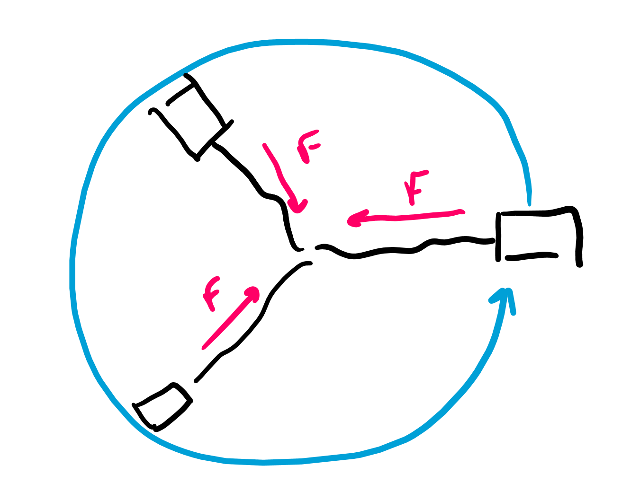
Planets orbit
When things move in a circular path, they are acted on by an inward force
If you swing a charging cable around, you pull the cable inward but the cable moves in a circle
Gravity is the “inward force” planets have

Slide 16
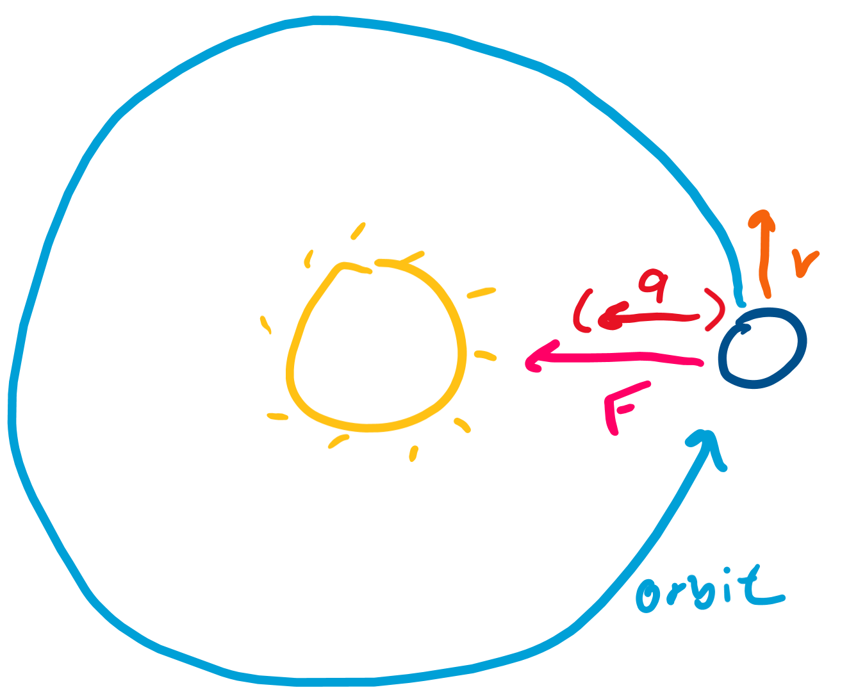
Velocity
If a planet moves in a circle, its velocity is perpendicular to the acceleration
(If we zoom in on the orbit, the change in position is almost a straight line)

Slide 17
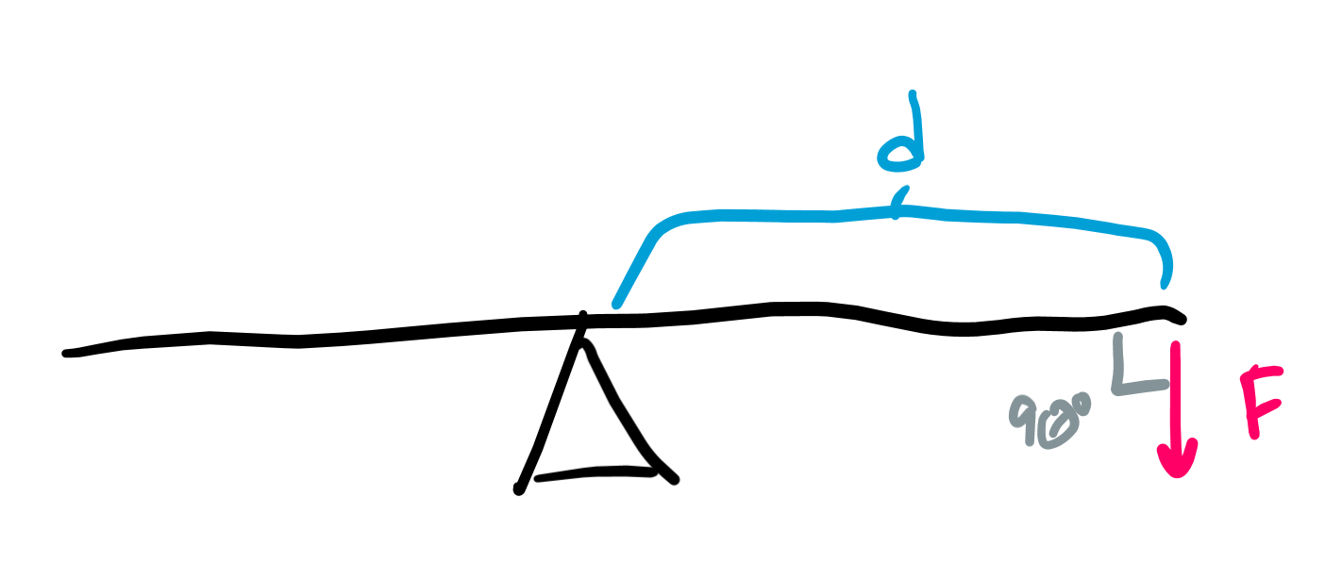
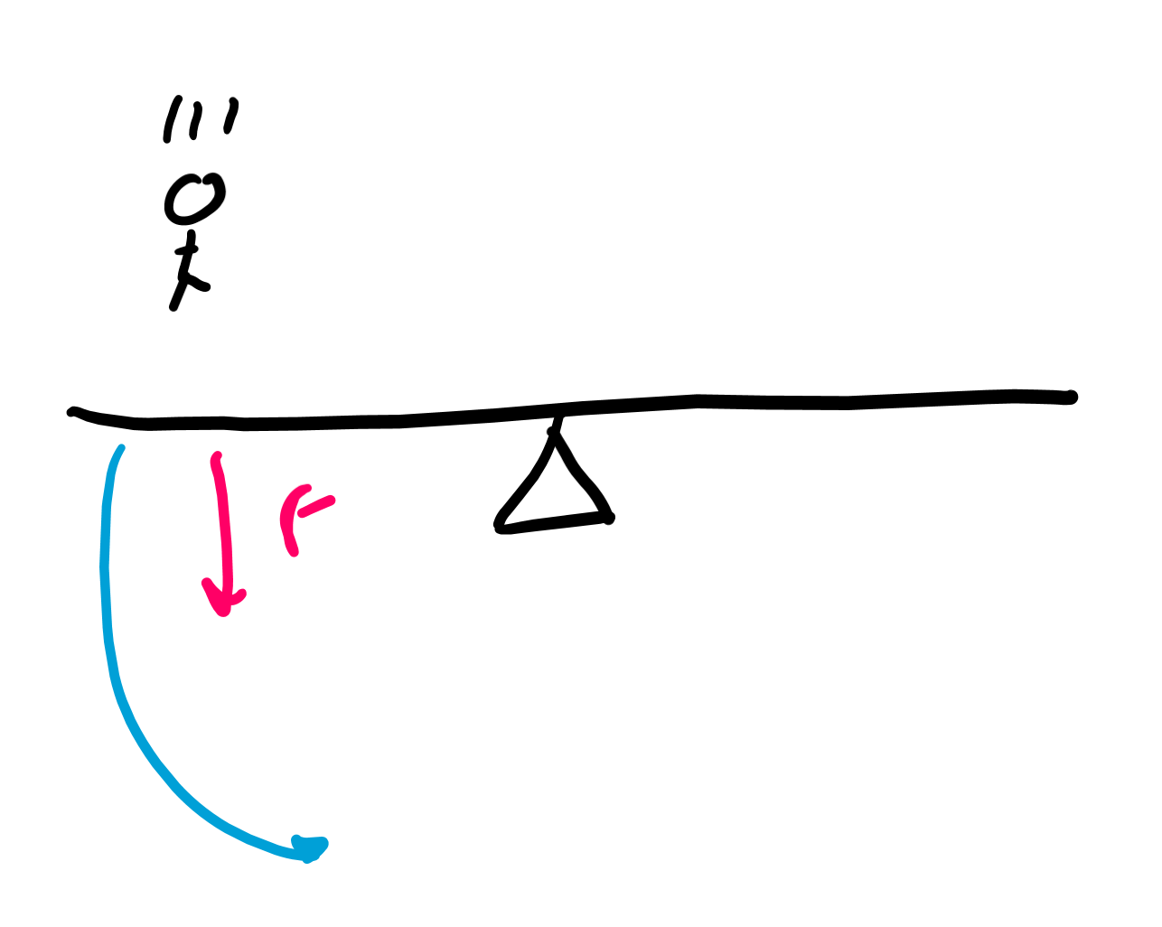
How to change velocity?
Torque!
This is when we apply a force perpendicular to some “pivot point”
When you jump on a see-saw, you apply a force perpendicular to the “arm” of the see-saw and cause it to rotate

Slide 18
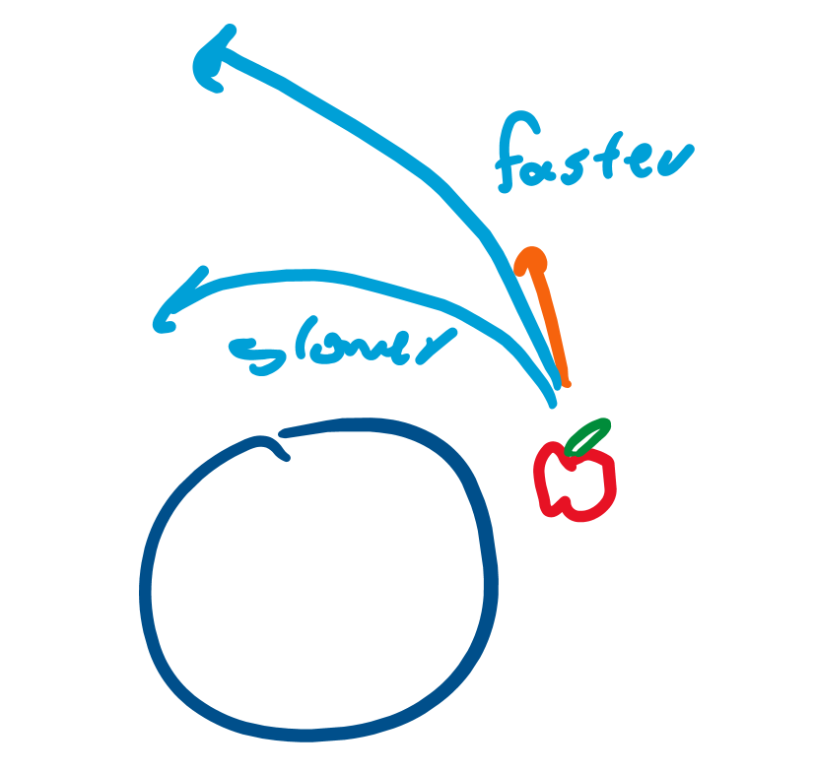
Increasing velocity
If we speed up the spinning object, the orbit size gets bigger!

